Slide 1

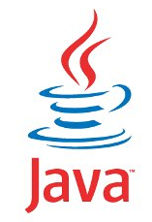
FULL STACK WEB DEVELOPMENT WITH JAVA
Lecture-1
(Introduction To JDBC)

Slide 2
Introduction To JDBC
Unofficial full-form of JDBC is Java Database Connectivity.
It is an API used for connecting programs written in Java with the Relational Database.
Programs developed with Java/JDBC are platform and vendor independent.

Slide 3
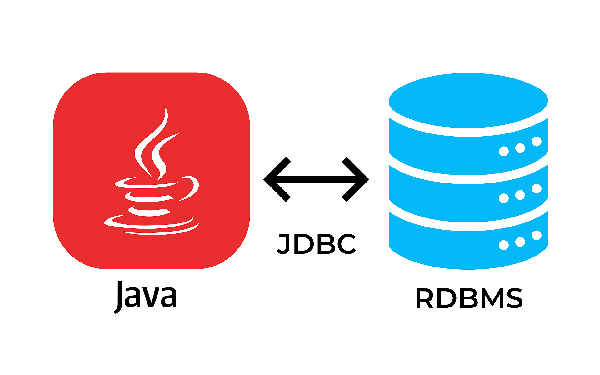
Introduction To JDBC

Slide 4
Some Popular RDBMS
Some of the most popular RDBMS are:
Oracle
MySQL
MS SQL Server
SQLite
PostgreSQL
IBM DB2
and many more

Slide 5
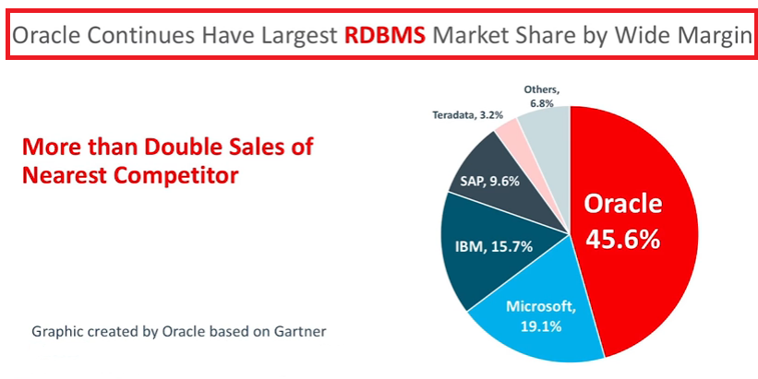
The Market Leader

Slide 6
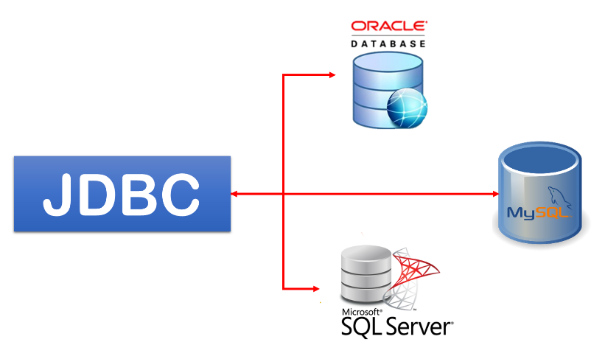
Introduction To JDBC

Slide 7
History And Edition
JDBC is maintained by JavaSoft, a sister concern of Oracle.
It was released as a part of JDK 1.1 and was called JDBC 1.0.
Later in 2006 , with Java 6, JDBC 4.0 was released
Java SE 9 includes the latest version of JDBC called JDBC 4.3

Slide 8
How JDBC Maintains Connection To The Database ?
JDBC communicates with the database using a special set of classes called Driver classes .
These Driver classes perform the real communication with the database in it’s native form.
Further to manage these Driver classes the JDBC API provides another top level class called DriverManager

Slide 9
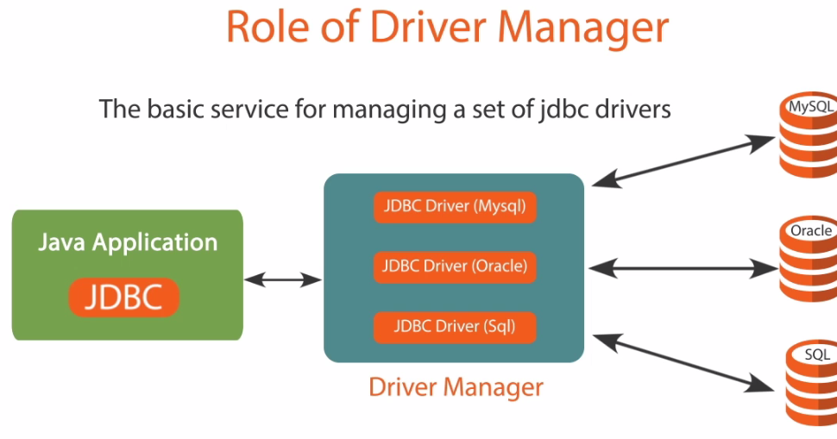
How JDBC Maintains Connection To The Database ?

Slide 10
JDBC Driver Types
Today, there are four types of JDBC drivers in use:
Type 1: JDBC-ODBC bridge Driver.
Type 2: Native Driver.
Type 3: Network API Driver
Type 4: Pure Java Driver

Slide 11
JDBC-ODBC Bridge Driver
The JDBC-ODBC bridge driver uses ODBC driver to connect to the database.
ODBC stands for Open Database Connectivity and is a Microsoft technology
The JDBC-ODBC bridge driver converts JDBC method calls into the ODBC function calls.

Slide 12
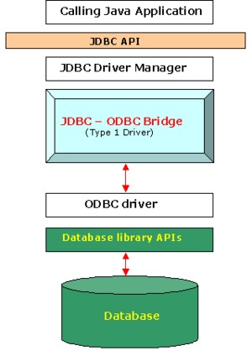
Architecture

Slide 13
JDBC-ODBC Bridge
A type 1 JDBC driver consists of a Java part that translates the JDBC interface calls to ODBC calls.
An ODBC bridge then calls the ODBC driver of the given database i.e. the driver converts JDBC method calls into ODBC function calls.
Sun provides a JDBC-ODBC Bridge driver: sun.jdbc.odbc.JdbcOdbcDriver.
Continued

Slide 14
JDBC-ODBC Bridge
Advantage:
Can be used to connect with variety of databases.
No installation required as it comes bundled with JDK.
Continued

Slide 15
JDBC-ODBC Bridge
Disadvantage:
This is the slowest driver.
Since it is a Microsoft technology so our Java application can use it only when it runs on Windows platform.
It only supports basic SQL types like varchar2,number,date but doesn’t supports advanced types like BLOB,CLOB etc
Continued

Slide 16
Native Driver
A type 2 JDBC driver is like a type 1 driver, except the ODBC part is replaced with a native code part instead.
The native code part is targeted at a specific database product i.e. uses the client-side libraries of the database product.
The driver converts JDBC method calls into native calls of the database native API.

Slide 17
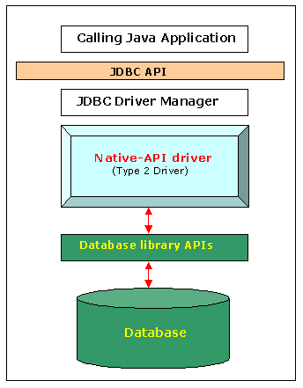
Architecture

Slide 18
Native Driver
Advantage:
This architecture eliminated the need for the ODBC driver.
Directly calls the native client libraries shipped by the database vendors
Continued

Slide 19
Native Driver
Disadvantage:
This is not pure java solution.
Although it is faster than type 1 driver but performance is still slow because it uses JNI technology for native calls
Continued

Slide 20
Network Driver
A type 3 JDBC driver is an all Java driver that sends the JDBC interface calls to an intermediate server.
The intermediate server then connects to the database on behalf of the JDBC driver.
The middle-tier (application server) converts JDBC calls directly or indirectly into the vendor-specific database protocol.

Slide 21
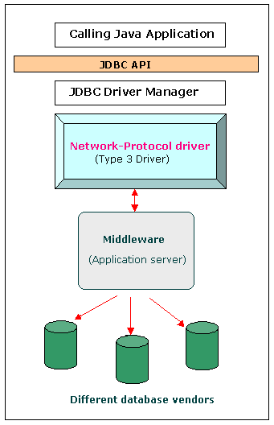
Architecture

Slide 22
Network Driver
Advantage:
Type 3 drivers sought to be a 100% Java solution.
Type 3 drivers had a Java client component and a Java server component, where the latter actually talked to the database.
Continued

Slide 23
Network Driver
Disadvantage:
Although this was technically a full Java solution, the database vendors did not like this approach as it was costly – they would have to rewrite their native client libraries which were all C/C++.
In addition, this didn’t increase the architectural efficiency as we are really still a 3 tier architecture
Continued

Slide 24
Pure Java Driver
It is also called thin driver or vendor specific driver.
This is because it converts JDBC calls directly into the vendor specific database protocol.
Moreover it is fully written in Java language.
Continued

Slide 25
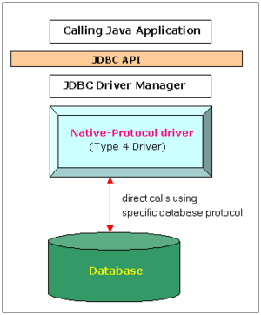
Architecture

Slide 26
Advantage And Disadvantage
ADVANTAGE:
Better performance
No middleware is needed while connecting to the database.
DISADVANTAGE:
Drivers are dependent on database.
There is a separate driver for each database.

